Slide 1
Problem Statement Title: Personalized Product Recommendations
Team Name: console_log

Slide 2

Team members details
Team Name | console_log
Institute Name | Indian Institute of Technology, Guwahati
Team Members > | 1 (Leader) | 2 | 3
Name | Mohit Manoj | Akanksha Gupta | Nidhi Shrivastava
Batch | 2024 | 2024 | 2024

Slide 3
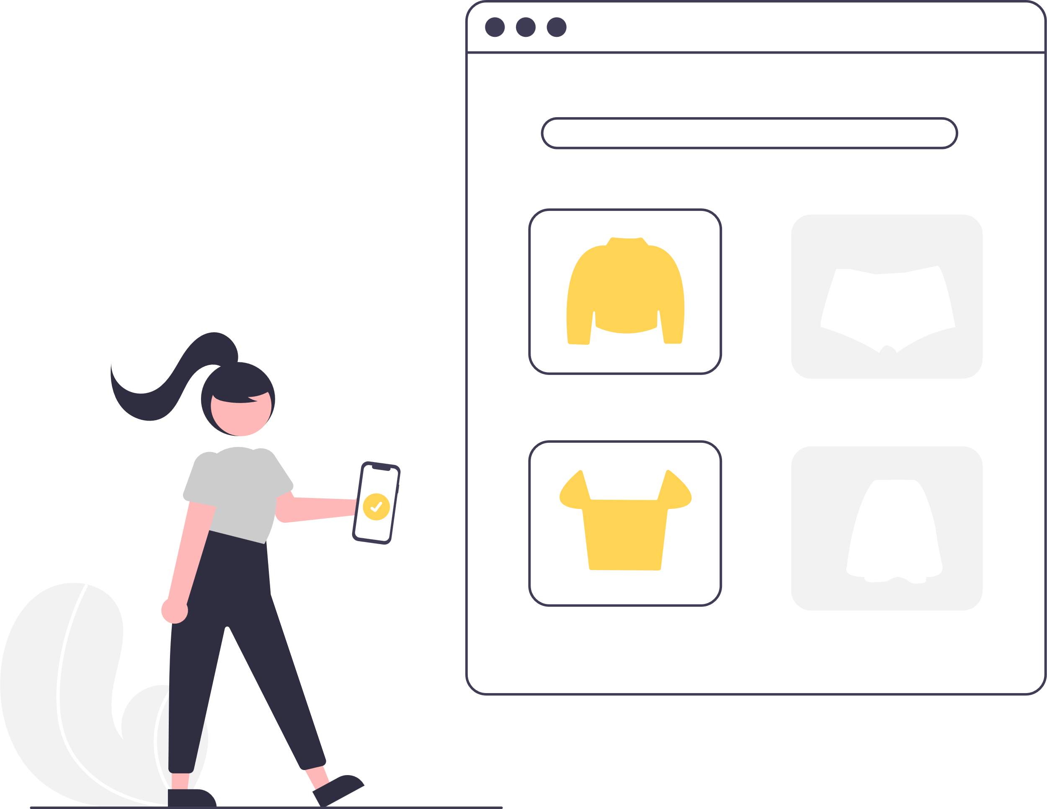
Objective
Implement a personalized product ranking system to enhance user experience
Consider factors like user preferences, past interactions, product popularity and user similarity.
Simulate user interactions to make a dynamic model

Slide 4


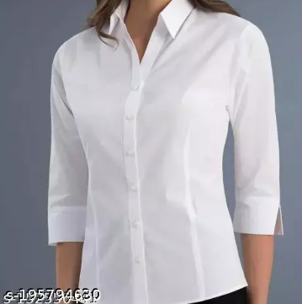




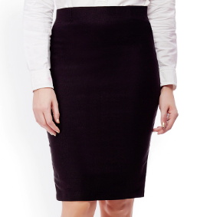
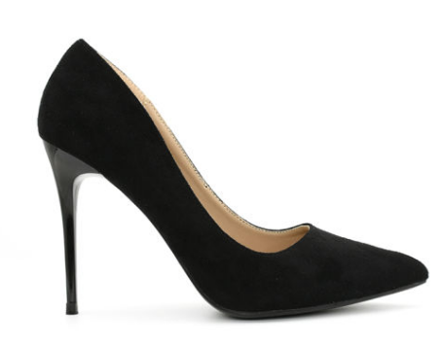
Use Cases
Women Fashion
Dresses
Skirts
Denims Tops Kurtis
Shirts
Sarees
Women Fashion
Shirts
Tops
Kurtis
Dresses
Skirts
Denims
Sarees
User signs up
Categories
Personalized Categories Ranking
Ranked products for each category
Similar Products
Complementary Products

Slide 5
Solution Overview
Home Screen
Uses Thompson Sampling to rank and re-rank categories from most appropriate to least appropriate.
RL Model
Choice to update model
Category
Category Screen
Recommends similar products.
People who bought this also bought these products.
Collaborative and Content Filtering
Co-visitation Matrix

Slide 6
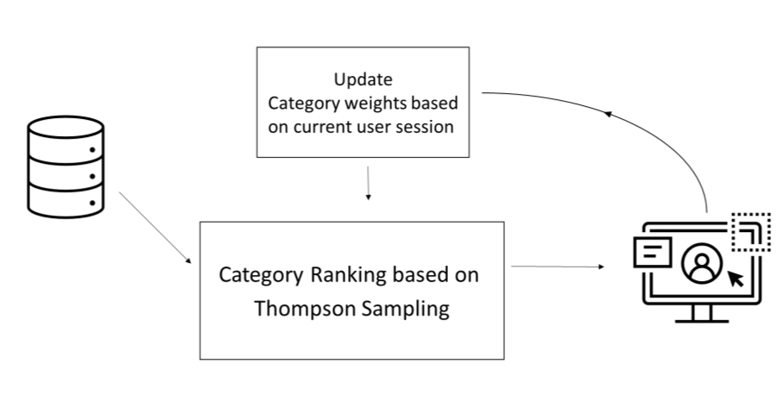
Proposed Approach
Category Recommendation
Category recommendation using Thomson Sampling.
Run Thompson Sampling twice – one for all users, and one for the current user.
Ensemble both probabilities with a weighted sum.
Sort categories in descending order based on ensembled probabilities.
Get category list of all users from previous sessions.
Use user’s choice as feedback to update model.

Slide 7
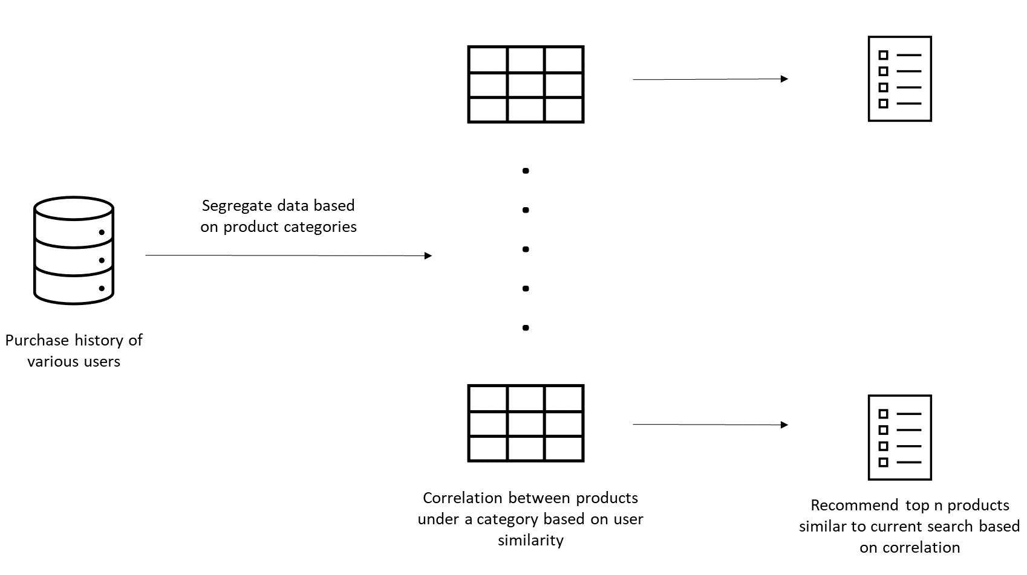
Proposed Approach
User Similarity
Product Recommendation using Collaborative Filtering
Created matrix of user-item purchase history
Extracted product embeddings on the basis of user purchase history
Calculated Cosine Similarity
between products
Analysed the user-item interaction using the past user purchase history
Used the purchase history of target user to recommend product using the similarity matrix.

Slide 8
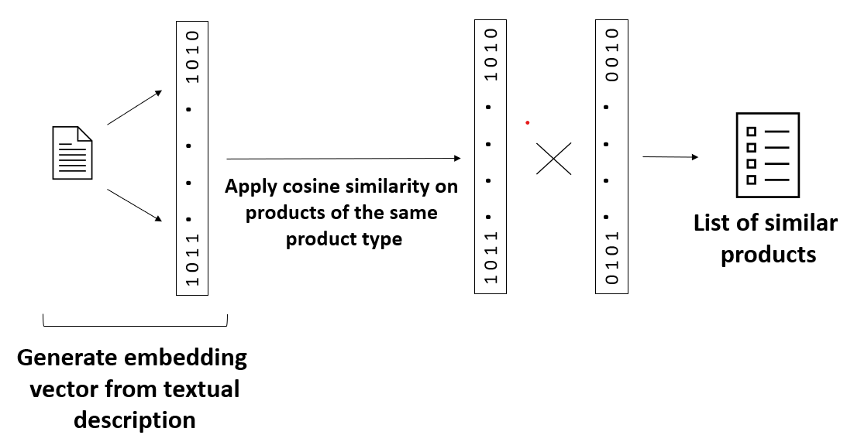
Proposed Approach
Product Similarity
Content Based Filtering
Generated embeddings of product descriptions using sentence transformer
Calculated Cosine Similarity between embeddings of target product and other products of same category
Extracted top N products based on the similarity score

Slide 9
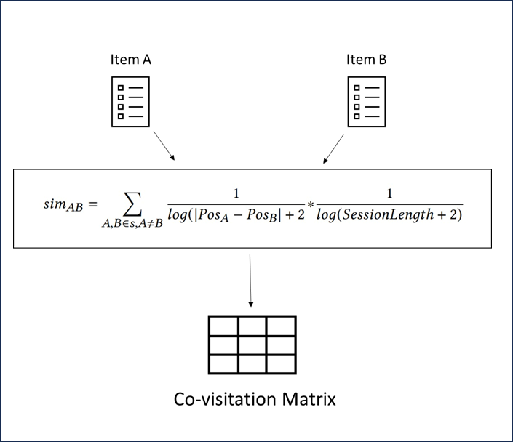
Proposed Approach
Customers who bought this also bought
Products recommendation using co-visitation matrix
Take every possible pair of items from user’s session history
Each pair is weighed depending on the position difference in sequence and total session length
Update the score for items as they reoccur in multiple user sessions
Each pair implies that when a user interacts with A it also interacts with B
Generate list of most favorable next item for each item based on the score
Score Calculation

Slide 10
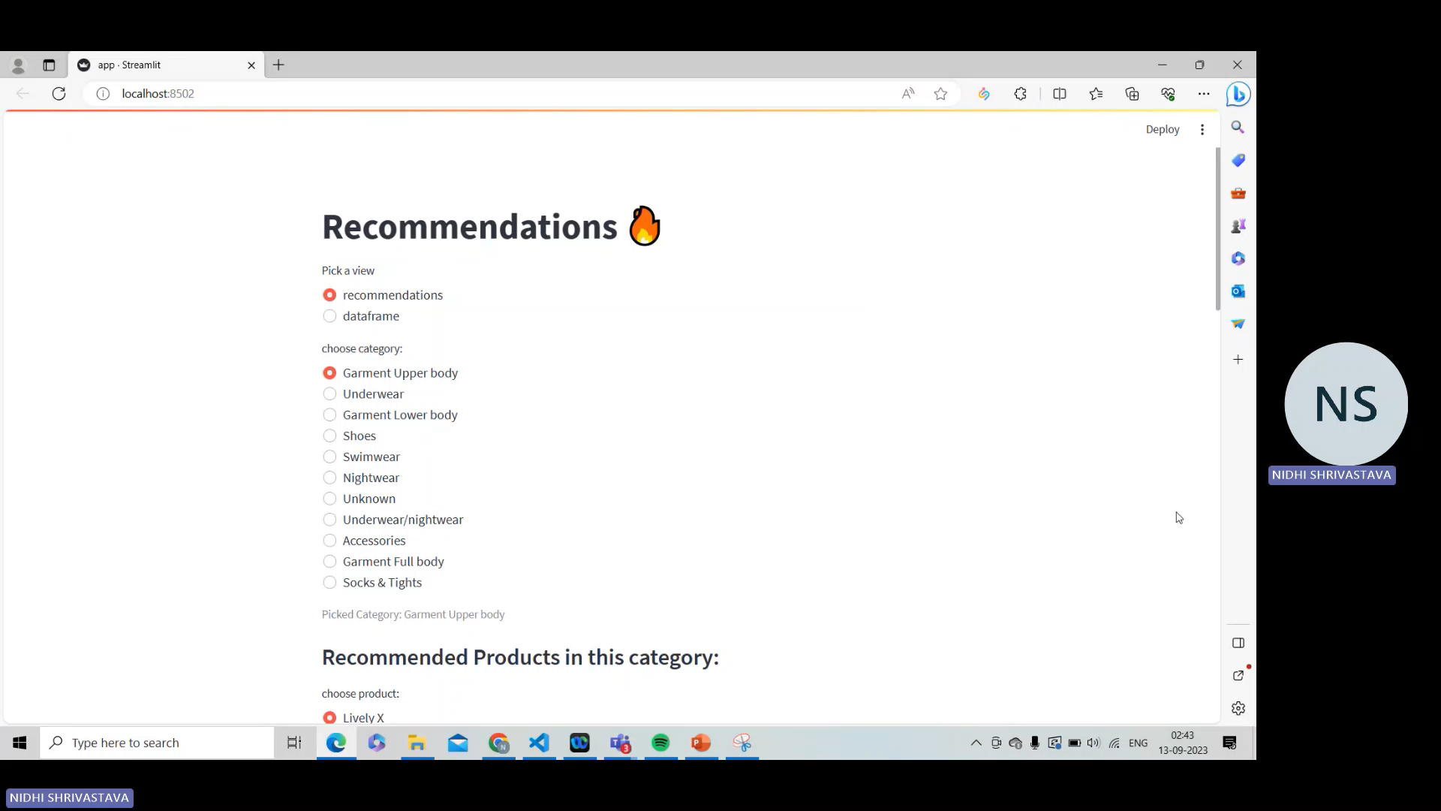
Demo

Slide 11

Evaluation Metrics
Click-Through Rate (CTR): Measures the ratio of clicks on recommended items to the total number of recommendations.
Average Order Value (AOV): Measures the increase in average order value.
Conversion Rate: Measures the percentage of users who make a purchase after receiving recommendations.
User Feedback and Surveys: Collect user feedback through surveys, ratings, and reviews to understand user satisfaction and perception of recommendation quality.

Slide 12


Strengths and Limitations
Learning from Interaction: Used Reinforcement Learning that allows the to learn through trial and error, to Re-rank categories.
User-Centric Recommendations: Used Collaborative Filtering that offers personalized recommendations based on similar user behaviors
Flexibility Across Domains: Our model is versatile and can be applied to a wide range of domains.
Sequential Decision-Making: RL excels in tasks involving sequences of decisions. It’s capable of optimizing long-term strategies, considering the cumulative impact of decisions.
Limited data: Techniques like Collaborative filtering require sufficient data to learn patterns and relationships.
Computational load: As the user and item base grows, the computation and storage requirements increases
Cold Start Problem: Our recommendation algorithms can struggle when dealing with new users or items that have limited historical data
Gray Sheep and Black Sheep Problem: It gets difficult to recommend products to users exhibiting preferences that deviates from the norm
STRENGTHS
LIMITATIONS

Slide 13




Future Scope
Algorithm
Extending Use Cases
Optimization: Reducing the computational load by creating clusters of similar users thereby segmenting the data into more relevant subsets
Trending near you: Using user demography to find the trending products in a region to create a sense of urgency and encourage exploration of new items.
Deep Learning algorithms: Image-based recommendations can suggest visually similar products based on shared visual features.
Personalized Deals: Offering exclusive discounts or deals on products that align with the customer's preferences and purchase history, creating a sense of personal value.
Graph Neural Networks capture intricate relationships, enhancing personalization, cross-domain suggestions, and mitigating cold start challenges.
Seasonal and Occasion-Based Recommendations: Recommending products suitable for specific seasons, holidays, or occasions, enhancing the relevance of our suggestions.

Slide 14
Thank You

